Slide 1
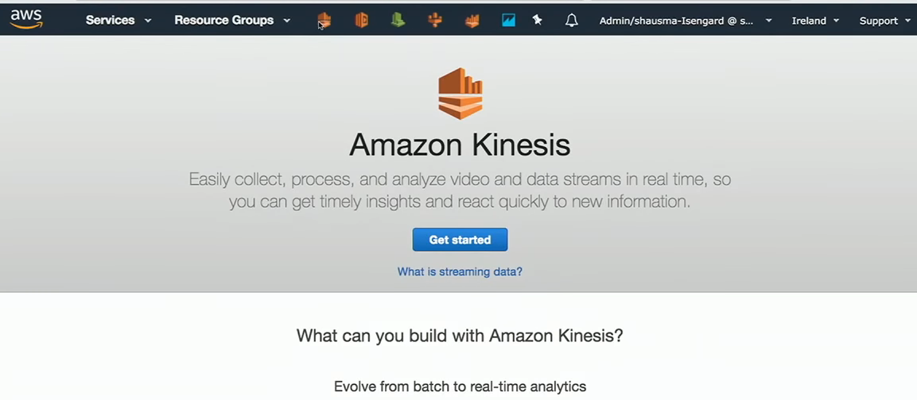
Build Your First Big Data Application on AWS Kinesis

Slide 2
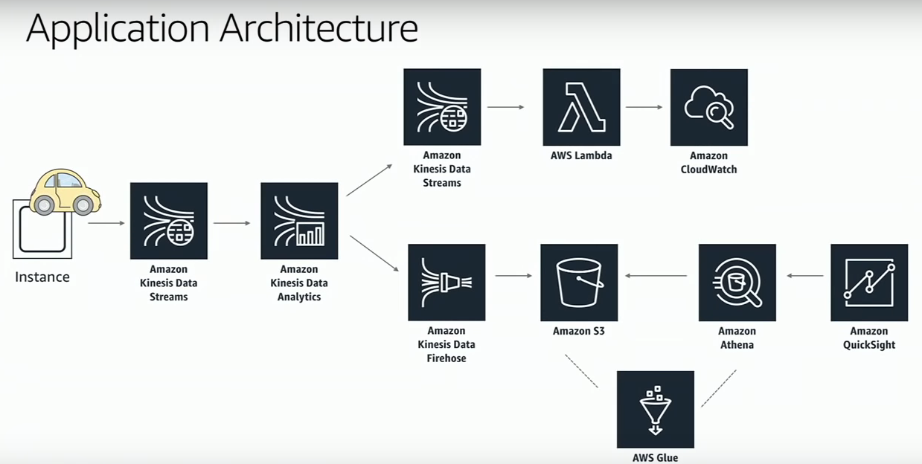
Analyzing Data Of Taxi Trips

Slide 3
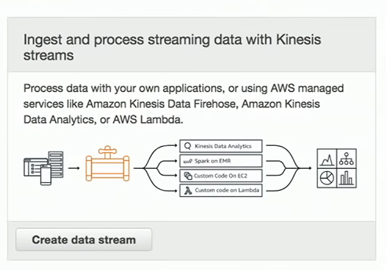
Create Data analytics pipeline

Slide 4
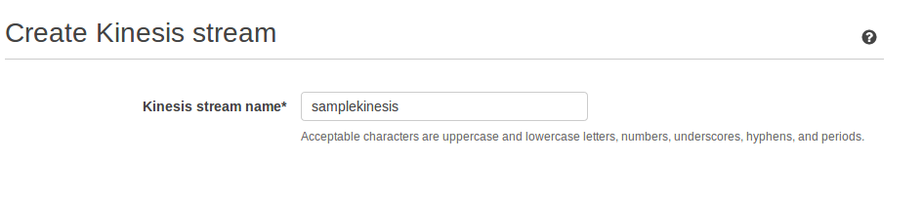

Slide 5
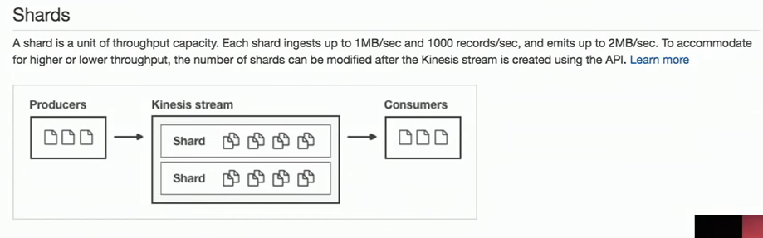
What is a shard

Slide 6
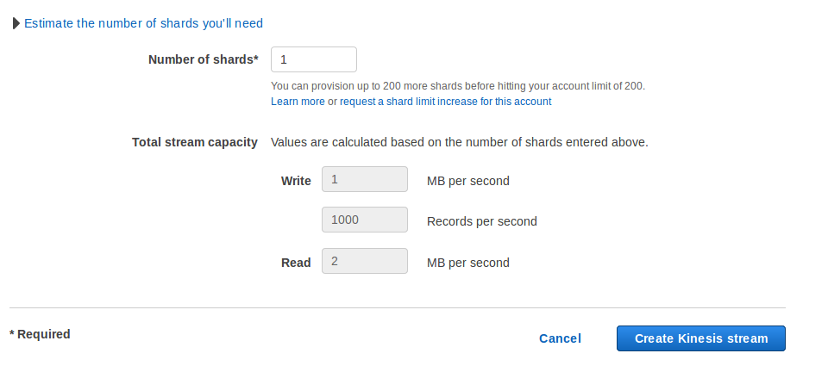
Specifying available records

Slide 7
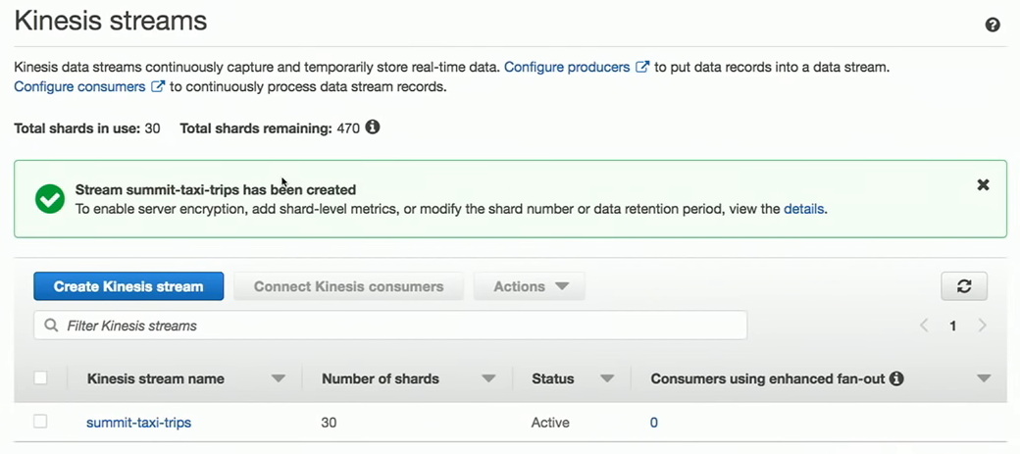
Creates new kinesis stream

Slide 8
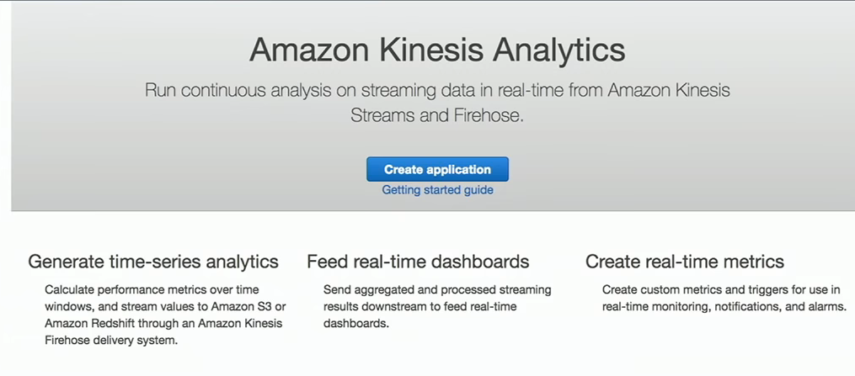
To create application

Slide 9
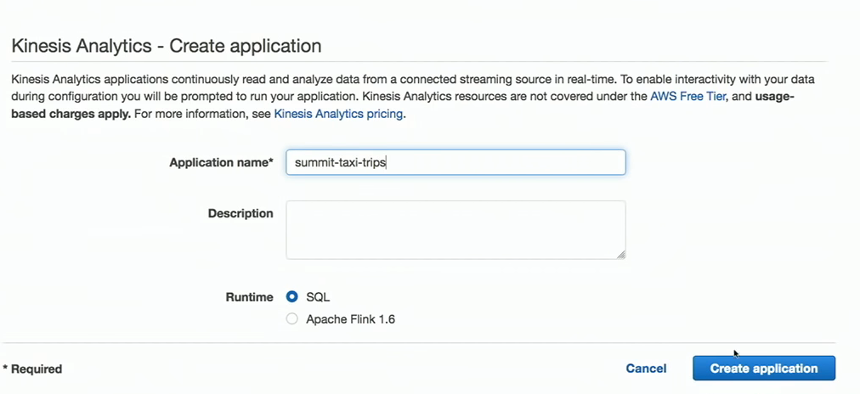

Slide 10
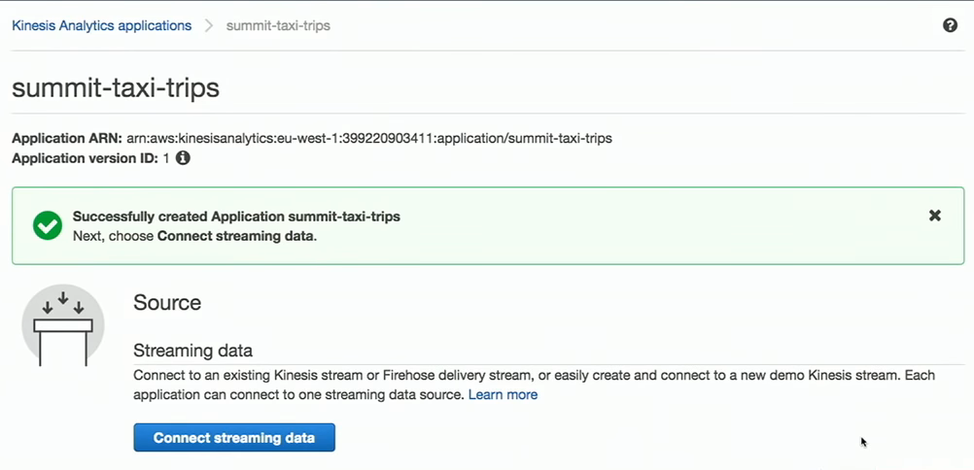
Application created

Slide 11
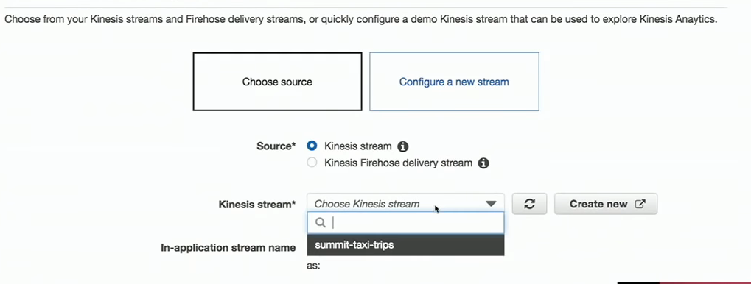
Connect streaming data source

Slide 12
What is schema
To convert your existing database schema from one database engine to another.
Your converted schema is suitable for an Amazon RDS, MySQL DB instance, an Amazon Aurora DB cluster, an Amazon RDS.

Slide 13
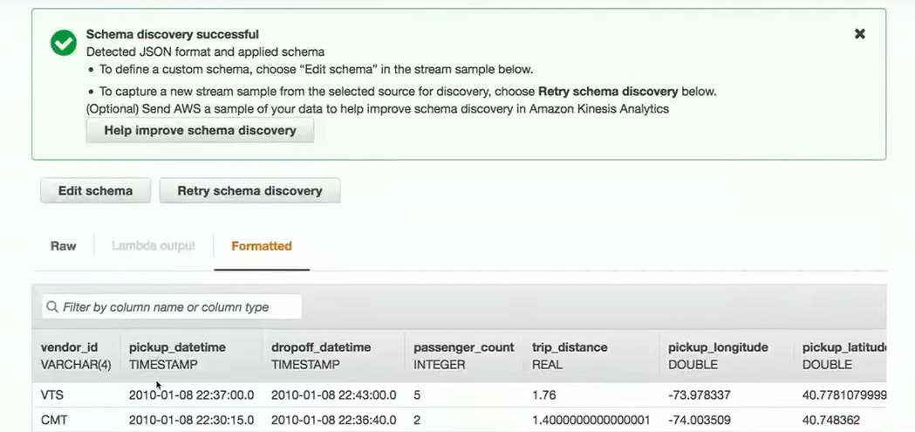

Slide 14
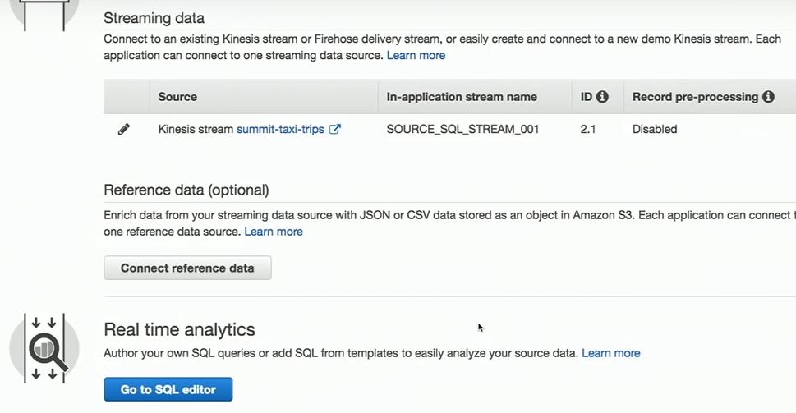
Adding SQL queries to SQL editor

Slide 15
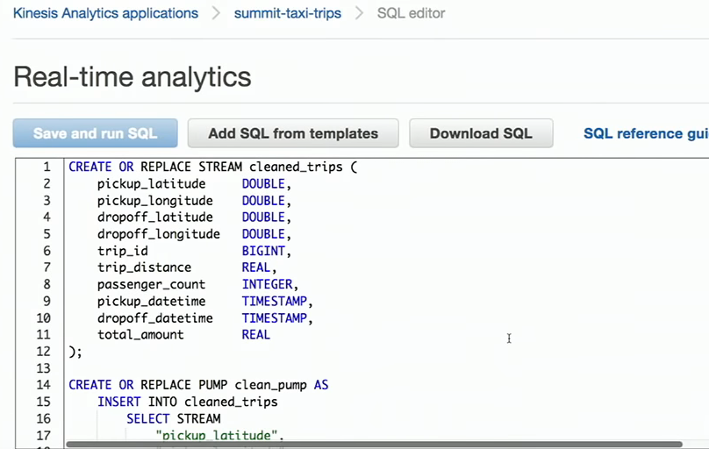
Save and run SQL

Slide 16
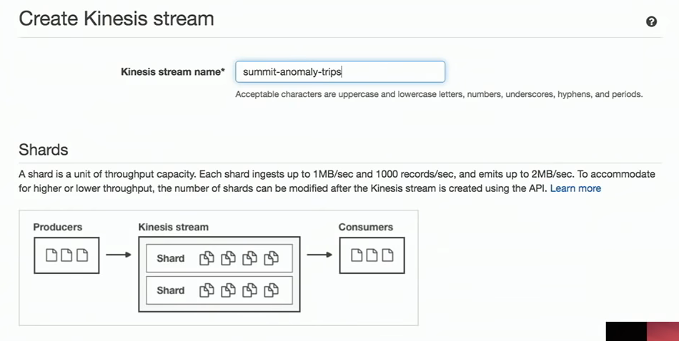
Create another kinesis stream

Slide 17
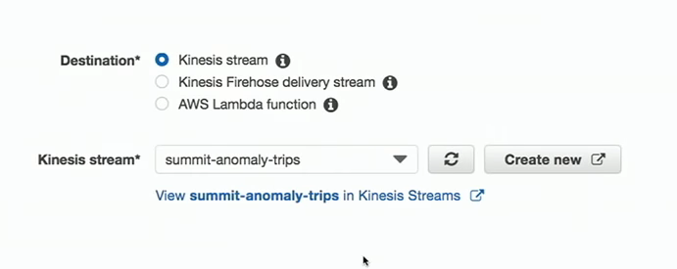
Connect to destination

Slide 18
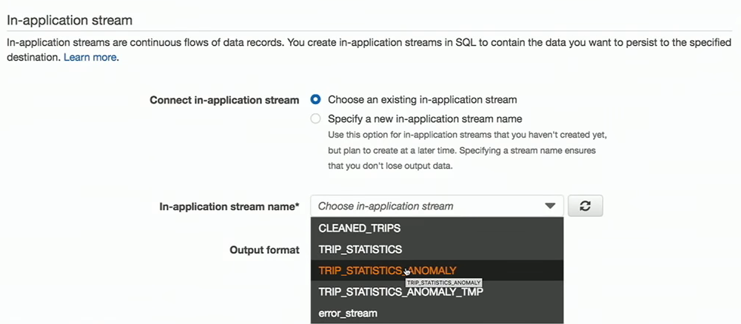

Slide 19
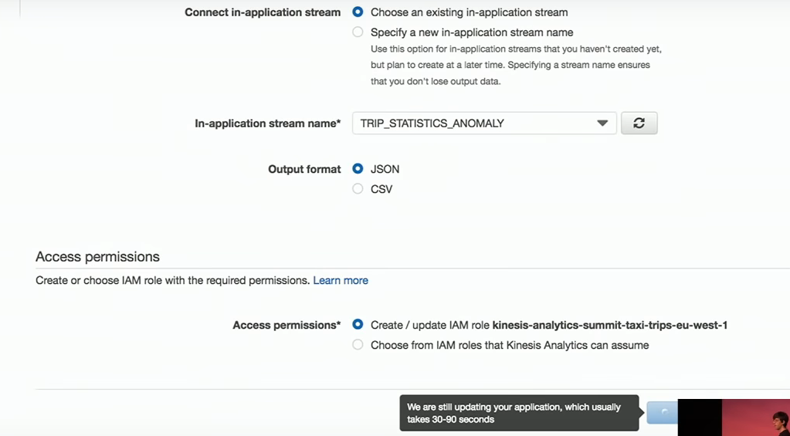
Update application

Slide 20
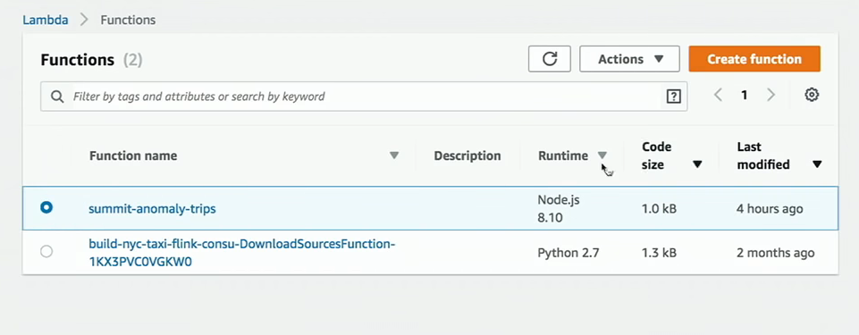
Creates lambda function

Slide 21
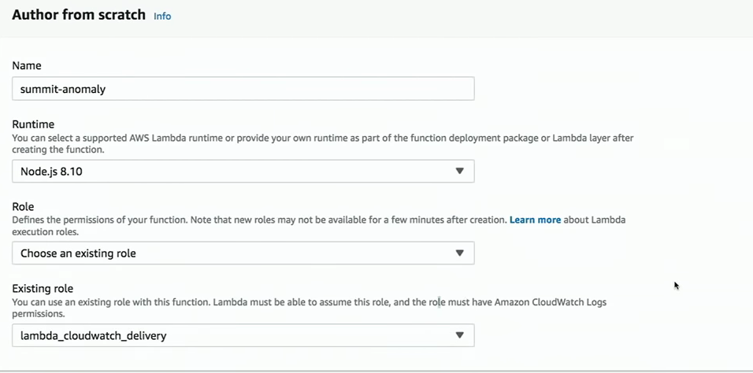
Glue btw kinesis stream & cloud watch

Slide 22
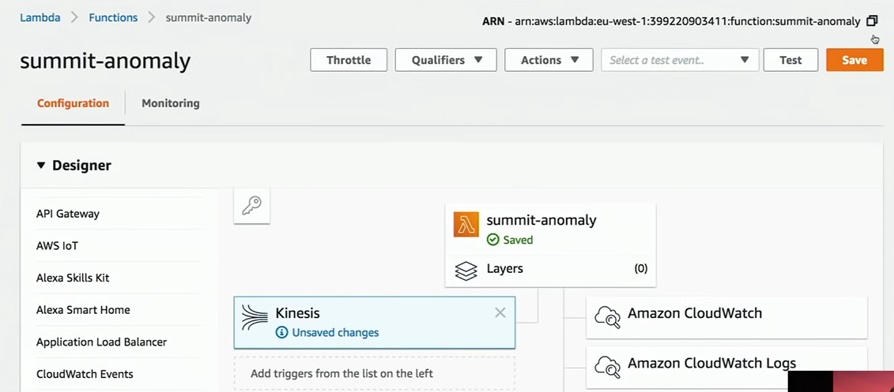
Connect kinesis to cloud watch

Slide 23
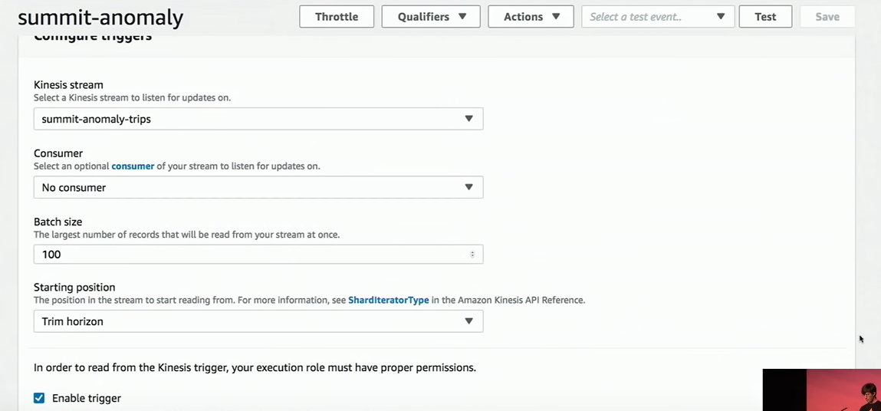
Connect lambda function to kinesis

Slide 24
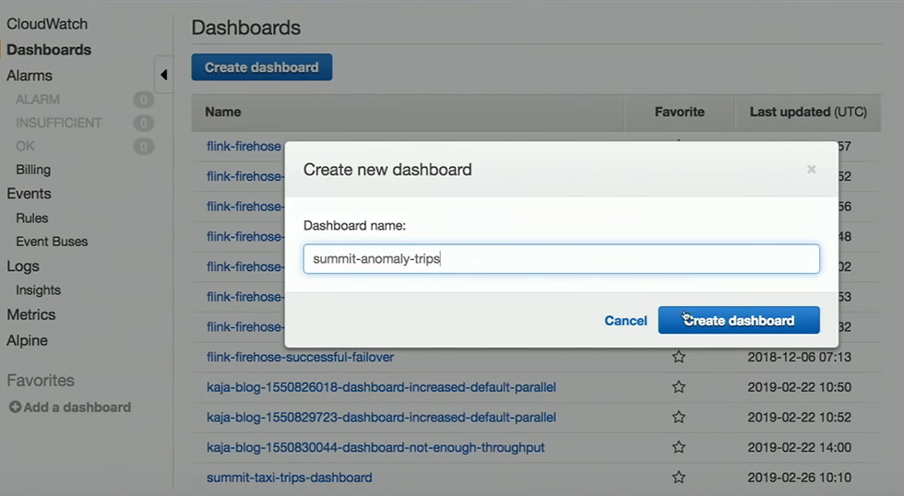
Create dashboard in cloud watch

Slide 25
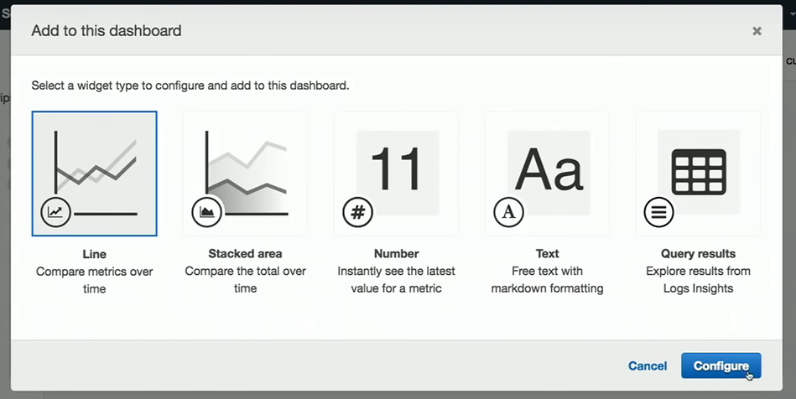
Select widget type

Slide 26
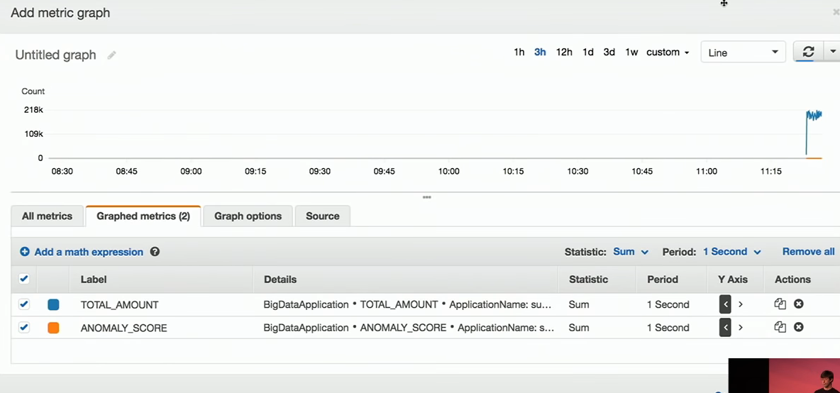
Metric to build dash board

Slide 27
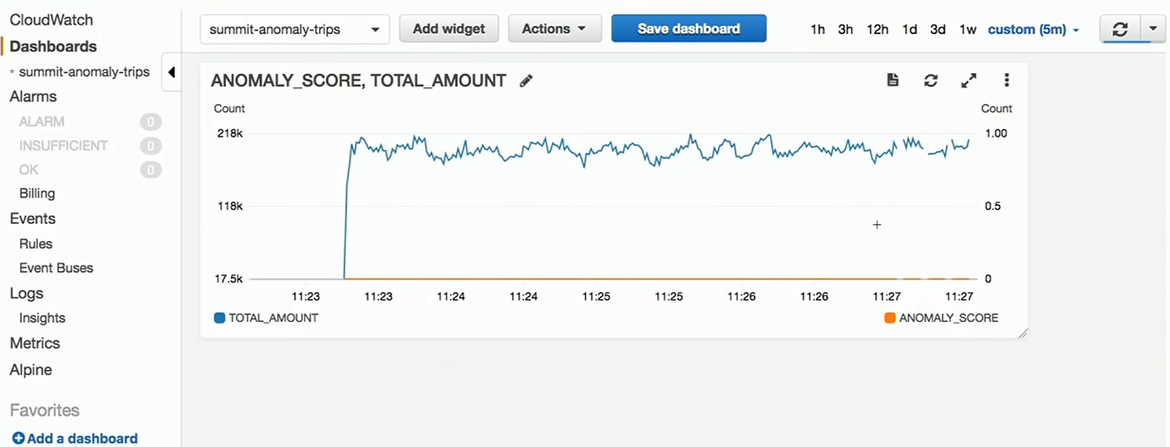
Dash board graph

Slide 28
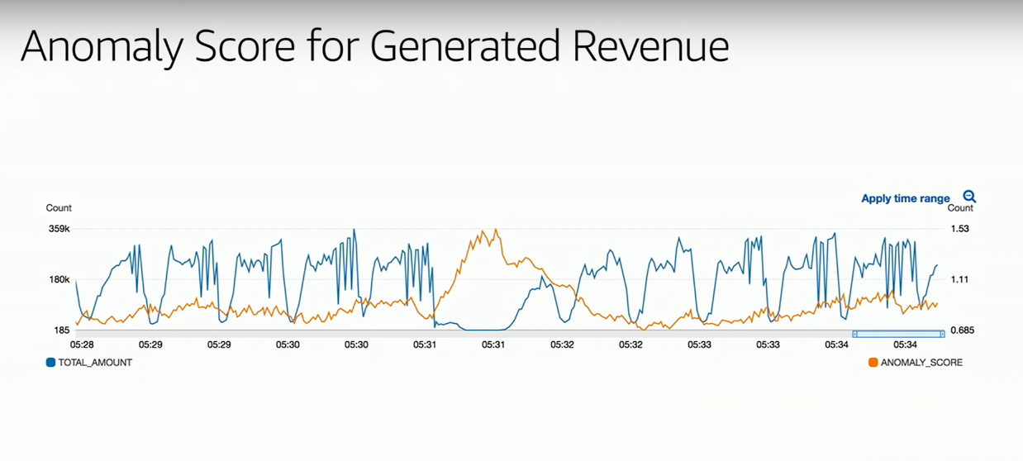
Graph after generating

Slide 29
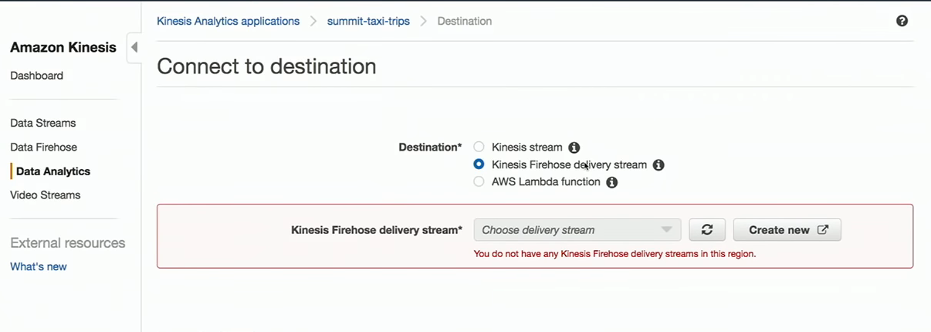
Create firehouse delivery stream

Slide 30
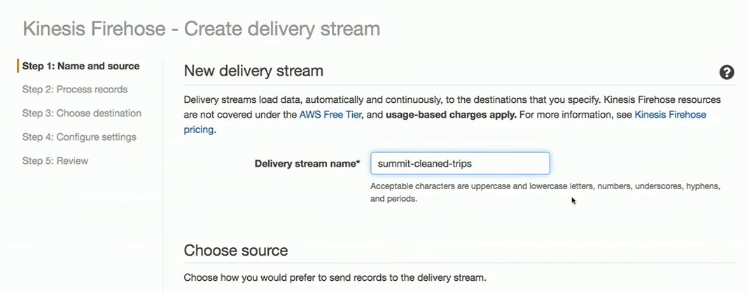

Slide 31
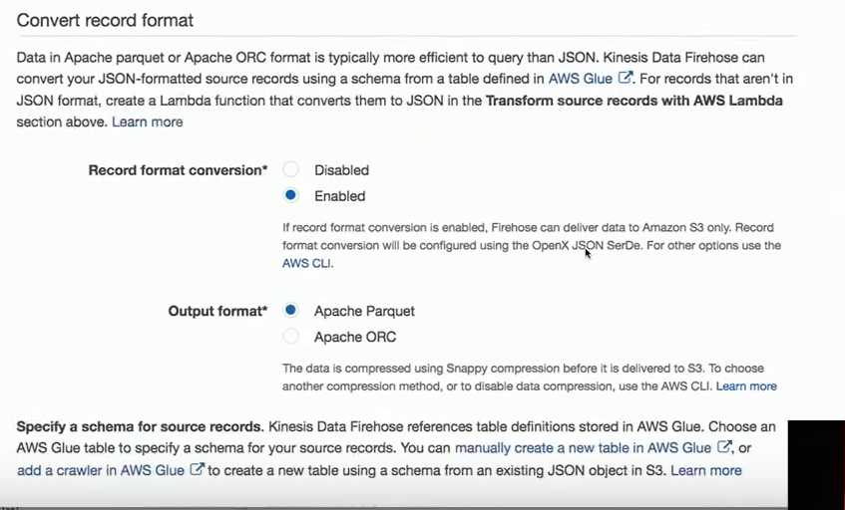
Firehouse deliver data to S3 only

Slide 32
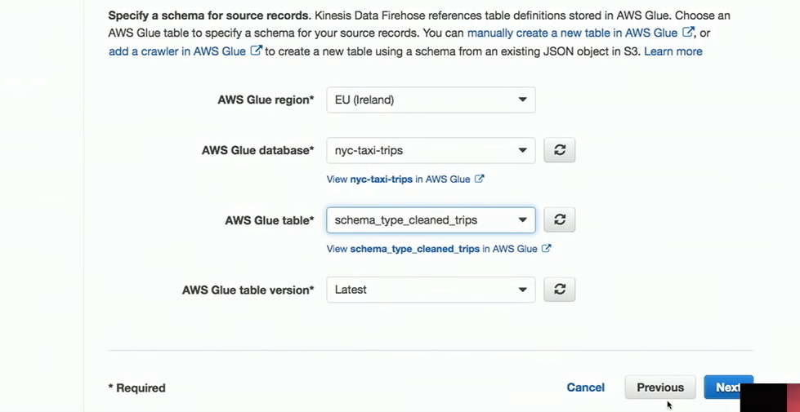
Specifying schema

Slide 33
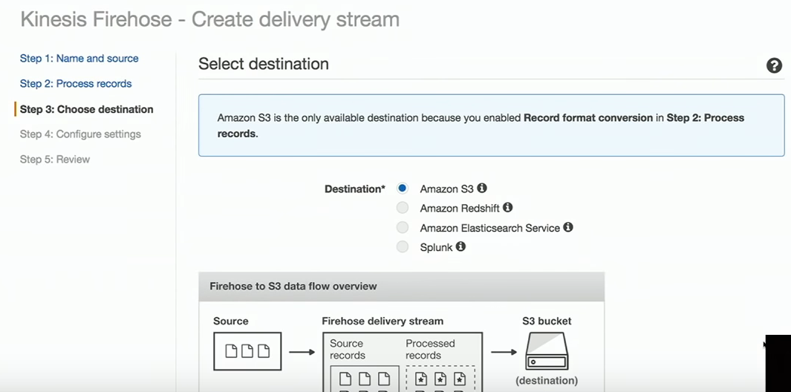
S3 destination

Slide 34
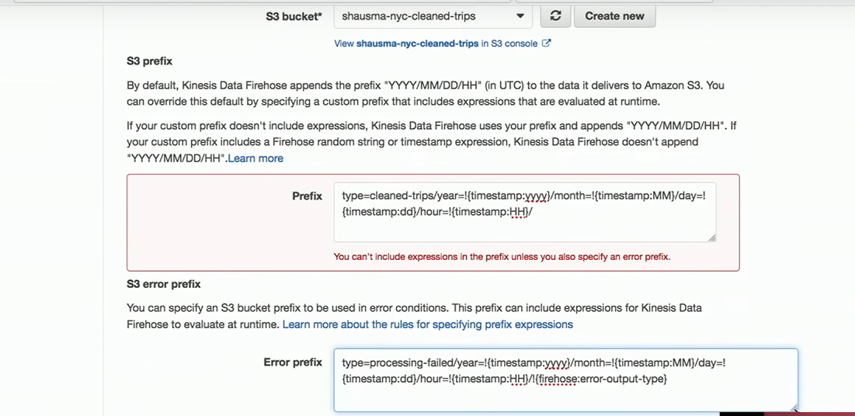
Specifying S3 prefixes

Slide 35
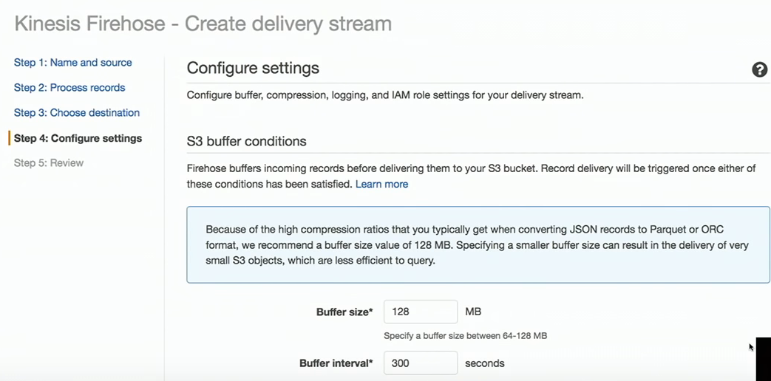
Control buffer conditions

Slide 36
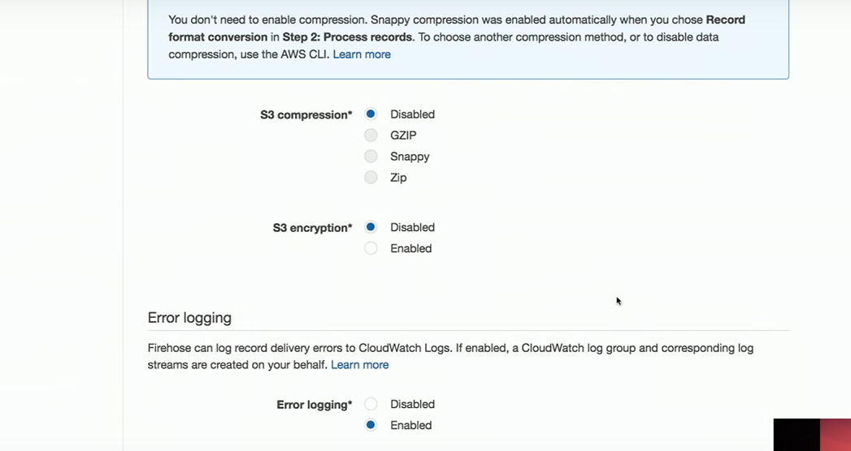
S3 Compression & Encryption

